Slide 1
CMSC 426 Principles of Computer Security
Hashing and Public Key Infrastructure

Slide 2
Last Class We Covered
Block cypher modes
Asymmetric encryption
Diffie-Hellman
RSA
Math (for real this time)

Slide 3
Any Questions from Last Time?

Slide 4
Today’s Topics
Man in the Middle Attacks
MAC
Hashing
HMAC
Public Key Infrastructure
Certificates
Digital signatures

Slide 5
Man in the Middle Attack (MITM)
Attacker secretly intercepts communication between parties
Communication is entirely relayed through the “middle man”
Attacker can alert course of “conversation” in various ways
Not passing on one or more messages
Injected new messages
Altering intercepted messages

Slide 6
MITM and Diffie-Hellman/RSA
Diffie-Hellman, attacker sits in the middle and negotiates a key with each side of the communication
To Alice, Eve pretends to be Bob; to Bob, Eve pretends to be Alice
As Alice and Bob communicate, Eve intercepts the messages, decrypts it, and re-encrypts it with her key
RSA, attacker performs a similar action, but using her asymmetric public and private keys to re-encrypt
In either case, Alice and Bob will not notice a difference

Slide 7
Violating the CIA Triad
Confidentiality
Users have no control over who sees information
Data is available to unauthorized persons
Integrity
Attacker can alter the contents of the data
Availability
Communication going through is dependent on the attacker forwarding it through
Even without modifying the information, can restrict means of communication
Integrity
Availability
Confidentiality

Slide 8
Violating Authentication
Authentication means that users and data can be verified to be genuine (and therefore trusted)
With the tools we currently know, MITM attacks will allow authentication to be violated as well
Simple example: in ECB mode, blocks can be rearranged
Authentication is distinct from confidentiality
Possible to authenticate a message without encrypting it

Slide 9
Message Authentication Codes

Slide 10
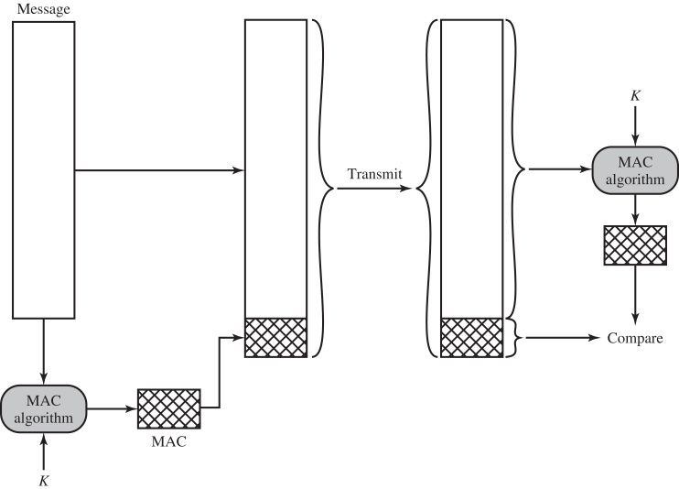
Message Authentication
A MAC algorithm is used to add a small “tag” to the end of a message
Message and tag transmitted
Receiver re-creates tag, and verifies that message has not been altered
Even un-encrypted, message can be authenticated
Image taken from Computer Security (Stallings & Brown)

Slide 11
Methods of Generating MACs
There are a variety of ways to generate MACs
Includes using symmetric encryption, public-key encryption, or a secret value
Won’t go into detail here; read the book if interested
In order for authenticity to be assured, it must be assumed that only the sender and receiver share the encryption key or secret value
We’ll discuss how this can be guaranteed later

Slide 12
Hashing

Slide 13
Secure Hash Functions
Also known as “one-way” hash functions
Purpose is to create a “fingerprint” of an input
To be useful for message authentication, hash functions must:
Be able to be used on data of any size
Must produce a fixed-length output
Must be relatively easy/efficient to produce for any input
Must be resistant with respect to:
Pre-image, weak collision, and strong collision

Slide 14
Notation
H ( )
The hash function
M
The message/input being hashed
h
The resultant hash
h = H( M )

Slide 15
Pre-Image Resistance
Should be resistant to construction of a “pre-image”
In other words, given an already existing h, it is not feasible to construct a message M such that H(M) = h
This property is why they are called “one way” hashes
Hash can easily be generated from message, but original message cannot easily be reverse-engineered from resultant hash
If a hash function is used on a key, this also means the key cannot be recovered by “reversing” the hash

Slide 16
Weak Collision Resistance
Should be resistant to targeted collision
In other words, given an already existing M, it is not feasible to construct another message N such that H(M) = H(N)
If a hash function was not resistant to weak collision, it would be possible for an attacker to replace a message with one with another meaning
Alice
Eve
Bob
I have your dog, sucker.
Lunch?
?
Digital Signature
Digital Signature
Why would Alice
take my dog? 😟

Slide 17
Strong Collision Resistance
Should be resistant to deliberate collision
In other words, should not be feasible to create two different messages M and N such that H(M) = H(N)
This is the “stronger” collision resistance, because its requirements allow the attacker to create any two messages
With “weak” collision resistance, they had to match an existing one
Prevents an attack where Eve creates two messages with the same value, sends the first one to Bob, and then claims that the second message was the one she actually sent (e.g., IOU $10 vs IOU $1000)

Slide 18
Brute Force Costs
If a hash is ideal, then with an output of size n, it should cost:
To construct a pre-image:
2^{n} hash computations (attempts)
To find a weak collision:
2^{n} hash computations
To find a strong collision:
2^{n/2} hash computations
Lower because of the “birthday problem” – sometimes called a “birthday attack”

Slide 19
Hash Uses
With encryption: append hash to plaintext P before encryption
E( P ⌢ H(P) )
Keyed hash: using secret authentication key K
Authenticate message M by appending h_{K} = H (M ⌢ K)
Digital signature: Alice encrypts the hash with her private key
sig = E( A, H(M) )
We’ll discuss this in more detail later today
We’re using P and M interchangeably here

Slide 20
Hash-Based Message Authentication Codes

Slide 21
HMAC
Improves on the security of basic keyed hash
Security of HMAC depends solely on the security of the hash function
HMACs use two “magic” numbers
ipad = 00110110 (36 in hex)
opad = 01011100 (5C in hex)
These do ~*~math~*~ things (they’re vital to the security proof)

Slide 22
HMAC Expression
1
K is padded with zeros to match hash block size and XOR’d with ipad
HMAC(K, M) = H( (K ⁺ ⊕ opad) ⌢ H( (K⁺ ⊕ ipad) ⌢ M ) )
2
M is appended to result
Result is hashed
3
4
Result is appended to XOR of K with opad
Result is hashed
5

Slide 23
Using an HMAC
Exactly as a keyed hash would be applied
Alice and Bob share a secret key K
Alice computes the HMAC of message M using key K
Sends M and the HMAC to Bob
Bob computer the HMAC of the received message
Checks that it matches the HMAC sent by Alice
If it matches, all is well!

Slide 24
Public Key Infrastructure

Slide 25
What is Public Key Infrastructure?
“The set of hardware, software, people, policies, and procedures needed to create, manage, store, distribute, and revoke digital certificates based on asymmetric cryptography.”
End goal is a secure, convenient way to acquire public keys
Keys are “bound” to identities via certificates
Helps to alleviate the problems caused by man in the middle attacks

Slide 26
X.509 Certificates
X.509 is simply the standard that defines the format that most public key certificates take
Certificates attest to the link between a key and an entity
Also contain information about when the certificate is valid, exactly who issued the certificate, and if it has been revoked
Issued by Certificate Authorities (CAs)
There are root CAs and intermediate CAs
An operating system/browser trusts a list of CAs by default

Slide 27
Certificate Contents
The entity the certificate was issued to
Their public key
Whether they are a CA or not
This is how intermediate CAs are designated
Serial number of certificate
Validity window (when it became valid, when it expires)
The entity that issued the certificate
How a revoked certificate is designated
This part is kind of broken

Slide 28
Alleviating Man in the Middle Attacks
By combining these different concepts, security can be increased to a point where MITM attacks aren’t feasible
Unless a Certificate Authority is compromised, in which case ¯\_(ツ)_/¯
Use PKI to ensure public key belongs to person who claims it
Ensure authenticity, help with confidentiality
Use HMAC (or MAC) to verify message is unaltered
Ensure integrity

Slide 29
Announcements
Paper 2&3 are due next Wednesday
Lab 3 is projected to come out next Wednesday
(Earlier than it says on the website schedule)
Topic will be cryptanalysis, and no VM will be involved
Exam grades will go up on Blackboard tonight
Lab 1 has also been graded, and grades will go up tonight

Slide 30
Image Sources
Penrose triangle (adapted from):
https://pixabay.com/en/optical-illusion-illusion-triangle-154081/

